Slide 1


USAID’s Open Data Policy
ADS 579 – Development Data
White House Office of Science and Technology Policy
October 21, 2014

Slide 2
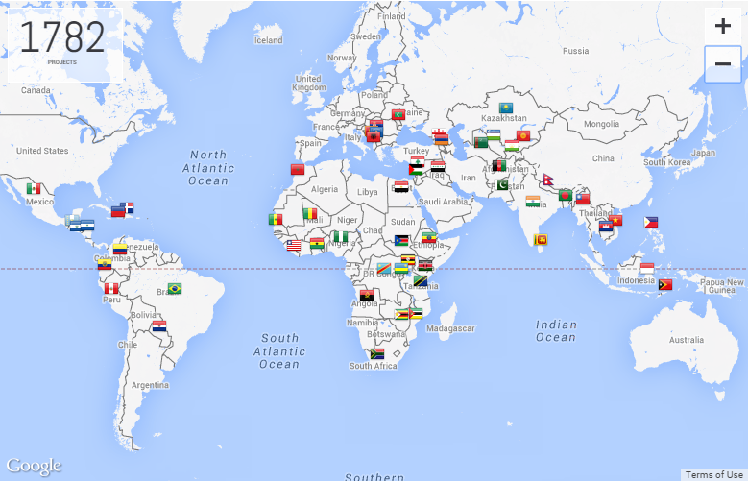
Mission Statement:
“We partner to end extreme poverty and to promote resilient, democratic societies, while advancing our security and prosperity.”

Slide 3
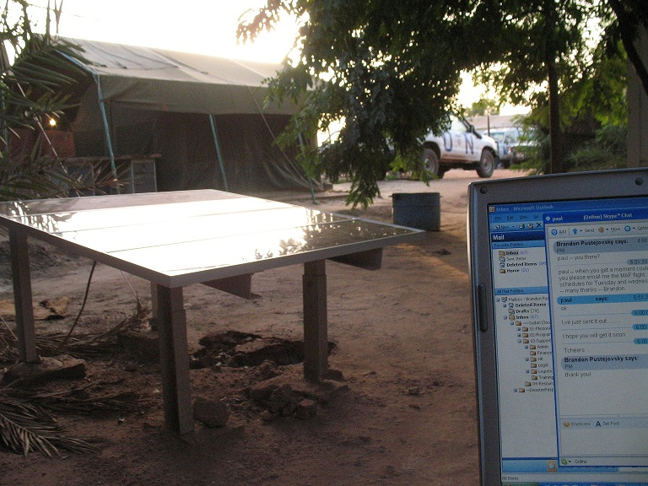
Illustrative Data Collection / Data Storage Location:

Slide 4






Pre-Policy Data Flow:
Grants, contracts, cooperative agreements
Narrative Reports via
Development Experience Clearinghouse
(dec.usaid.gov)
Implementing partners
International development programs
Aggregate data captured in corporate systems. - Raw datasets generally not included in central systems.
Program data

Slide 5



USAID - Funded Data
Access Challenges
USAID’s Open Data Policy
USAID Priorities
Ownership Questions
Specification of Deliverables
Science
Technology
Innovation
Partnership
Joint Funding
Cluster Samples
Baseline Household Surveys
Data Quality
Facility Surveys
Business Processes
Monitoring Data
School Attendance
Economic Assessments
Operations Data
Definition of Data

Slide 6
WHAT
USAID’s Open Data Policy:
Defines USAID’s Data Governance Structure
Information Governance Committee (InfoGov). Executive level committee to ensure Agency-wide buy-in and coordination.
Establishes Data Submission Mechanism via the Development Data Library (DDL)
Repository of USAID-funded data at www.usaid.gov/data
Outlines Standard Data Clearance Process
Reviews for privacy, personal security, and operational sensitivity, etc.
Creates Data Stewards in Every USAID Operating Unit
Local policy expert; provides guidance on data clearance.

Slide 7
HOW
Procurement Language
Effective for contracts, grants, cooperative agreements issued on or after October 1, 2014:
The Contractor / recipient must submit to the Development Data Library (DDL), at www.usaid.gov/data, in a machine-readable, non-proprietary format, a copy of any Dataset created or obtained in performance of this award, including Datasets produced by a subcontractor at any tier.
CORs / AORs Responsible for Ensuring Data Submission to DDL
Should include data as a deliverable in contracts whenever possible
Data Stewards Guide Operating Units on Policy Implementation
Continue socializing the open data mandate
Specialized training

Slide 8
NEXT STEPS
Internal socialization / change management across all USAID operating units
Increased public engagement, including policy feedback
Ongoing improvements to the Development Data Library
External engagement, including implementing partners
REFERENCES
Policy Announcement: http://1.usa.gov/1tF8COg
Policy: http://1.usa.gov/1zi21Mc
Fact Sheet: http://bit.ly/ADS579onepager

Slide 9
Questions?
Brandon Pustejovsky, Chief Data Officer
opendata@usaid.gov
bpustejovsky@usaid.gov ♦ 202-712-5418 ♦ Twitter: @bpushed

